Slide 1
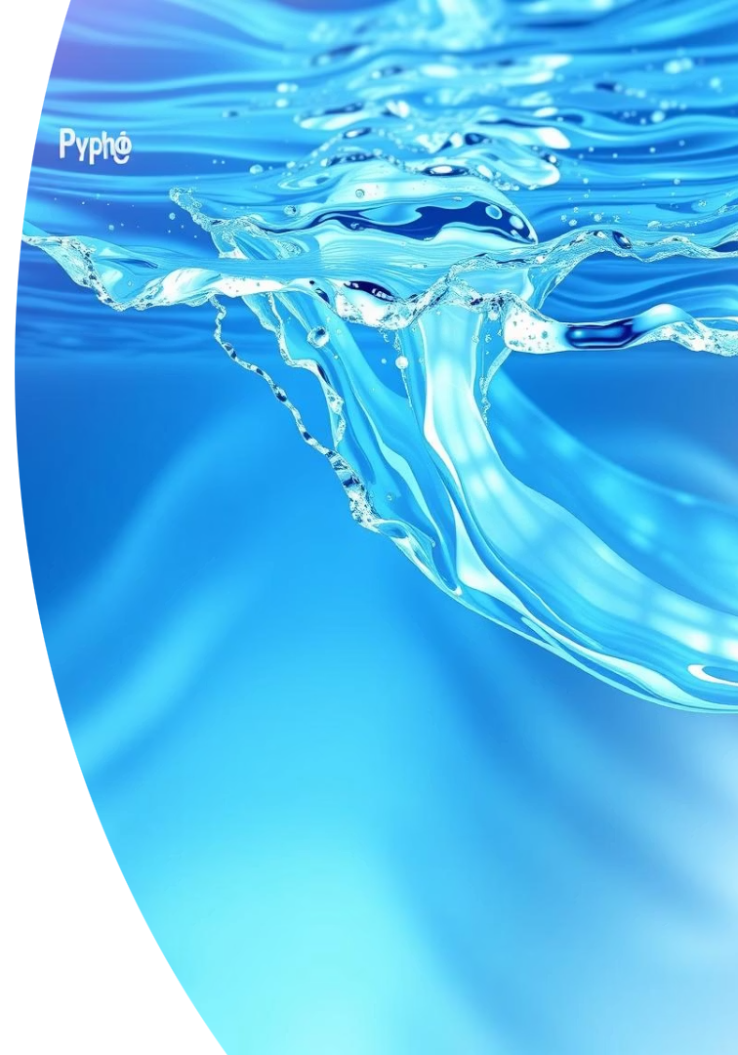

Water Quality Prediction Using Python: A Code-Driven Approach
This presentation explores predicting water potability using Python. We will cover data handling, model training, and evaluation. Our goal is to assess drinkability based on chemical attributes.
by Jay Kamavisdar

Slide 2

Data Loading and Initial Exploration
import pandas as pdinput_data = pd.read_csv("/content/drive/MyDrive/data.csv")input_data.head()input_data.info()input_data.describe()
We loaded the water quality dataset. Initial checks confirmed data types and basic statistics. This step ensures data integrity for further analysis.

Slide 3
Handling Missing Values
Missing values were identified across several columns. For simplicity, rows with any missing data were dropped. This ensures our dataset is complete for modeling.
input_data.isna().sum()cleaned_df = input_data.dropna()

Slide 4
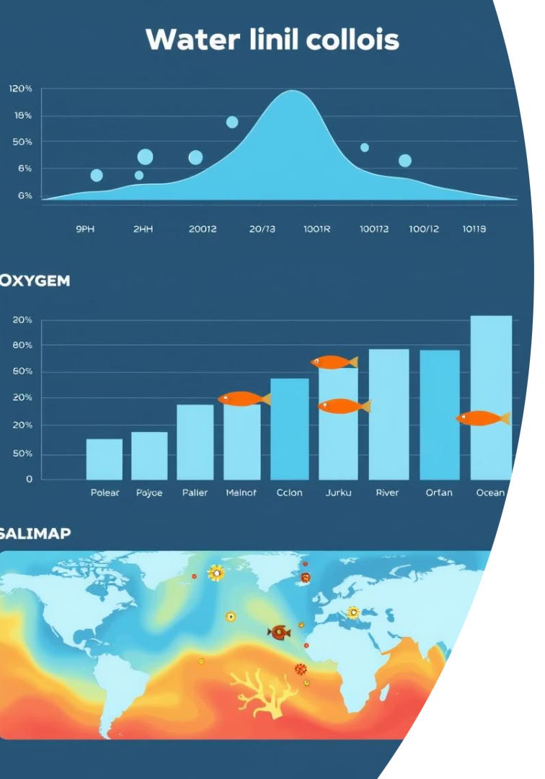



Exploratory Data Analysis (EDA)
Distributions
Correlations
Insights
Count plots revealed the balance of potable vs. non-potable samples. Histograms showed the spread of chemical attributes like pH.
Heatmaps illustrated relationships between features. Strong correlations suggest potential predictive power for water quality.
EDA helped us understand the data's structure. It guided our feature selection process. Visualizing the data uncovered hidden patterns.

Slide 5




Feature Selection & Engineering
Identify Target
The 'Potability' column was set as our target variable (y). This is what the model will predict.
Select Features
All other numeric attributes formed our feature set (X). These are inputs for the model.
No Engineering
No additional feature engineering was required. No encoding or scaling was applied at this stage.

Slide 6

Model Training
1
Split Data
2
Choose Model
The dataset was split into training and testing sets. An 80/20 ratio was used for development.
A Random Forest Classifier was selected for its robustness. It handles various data distributions well.
3
Train Model
The model was trained on the training data. It learned patterns from the chemical attributes.

Slide 7
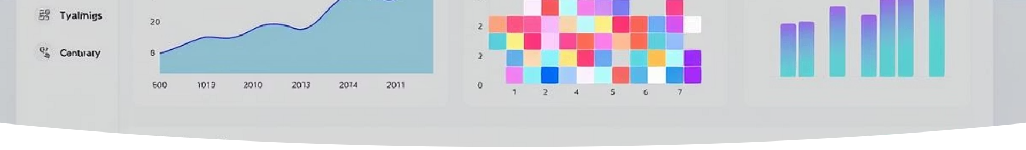
Model Evaluation
Model performance was assessed using standard metrics. Accuracy, a confusion matrix, and a classification report provided insights.
Accuracy
0.678
Precision (0)
0.70
Recall (0)
0.92
F1-Score (0)
0.79
Precision (1)
0.49
Recall (1)
0.17
F1-Score (1)
0.26
The model shows good accuracy for non-potable water. Potable water prediction needs improvement. This suggests class imbalance or feature limitations.

Slide 8

Exporting the Cleaned Data
Cleaned Dataset
CSV Format
The processed data, free of missing values, was saved. This ensures consistency for downstream tasks.
Data was exported as a CSV file. This is a universal format for data exchange.
Power BI Integration
The exported file is now ready for Power BI. It can be used for interactive dashboards.

Slide 9

Conclusion
1
Data Prepared
Raw data was loaded and meticulously cleaned.
2
Insights Gained
Visualizations highlighted key data distributions.
3
Model Developed
A machine learning model was trained and evaluated.
4
Results Exported
Cleaned data is ready for dashboard integration.

Slide 10

Next Steps
Improve Model
Focus on hyperparameter tuning to boost performance. Explore advanced ensemble techniques.
Real-time Predictions
Deploy the model using Flask or FastAPI for live analysis. Build a robust API endpoint.
Dashboard Integration
Connect the predictions to Power BI. Create interactive and dynamic visualizations for users.

